Slide 1

DAMG - 6210
Data Management and Database Design
Topic : E – Commerce Database Management System
Group – 10
HEMA SREE BOJANAPALLY
PRAKHYA DASARI
SWAPNIL SHANKARRAO BIRADAR
VENNELA BANDLA
SAHIL QURESHI

Slide 2
PROBLEM STATEMENT
An e-commerce company's manual system for managing online store operations is inefficient and prone to errors, leading to decreased customer satisfaction and profitability. A proposed automated database system using advanced data processing techniques, real-time analytics, and data visualization tools will improve efficiency, inventory management, order processing, and shipping logistics, resulting in increased customer satisfaction and profitability for the company.
Efficiency
Real Time Analysis
HIGHLIGHTS
Data Encryption
Scalability

Slide 3
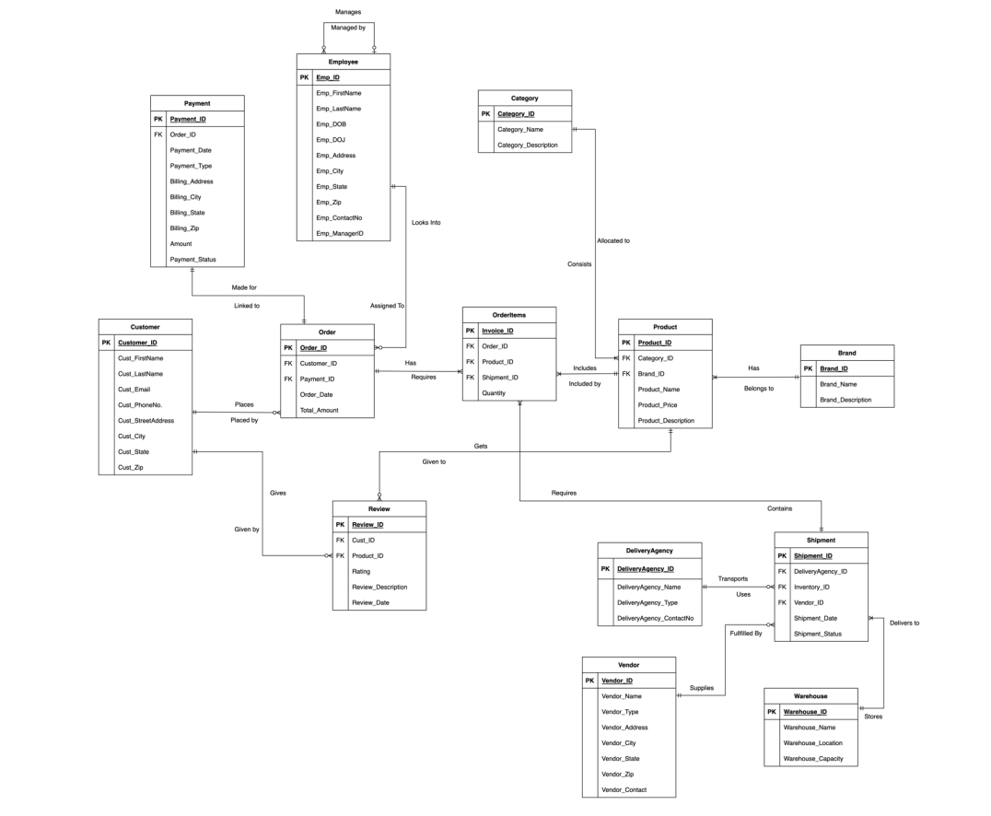
ENTITY RELATIONSHIP DIAGRAM

Slide 4
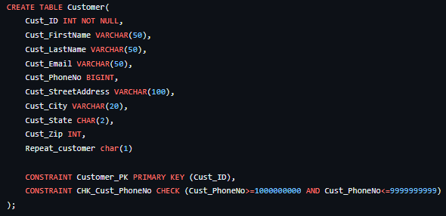
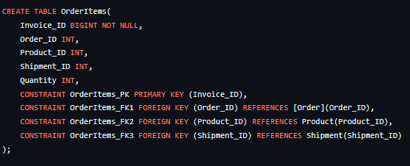
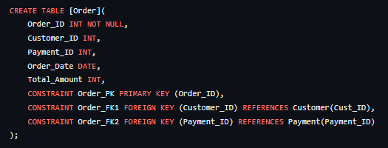
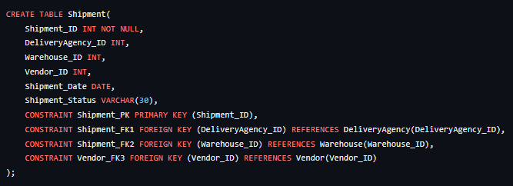
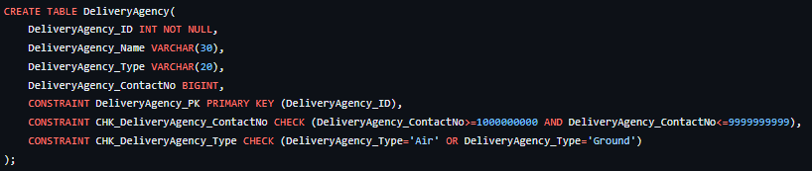
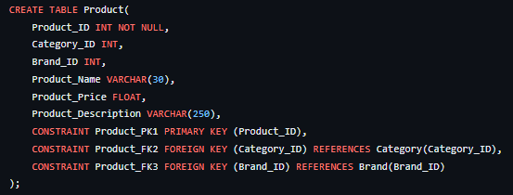
DATA DEFINITION LANGUAGE SCRIPTS

Slide 5
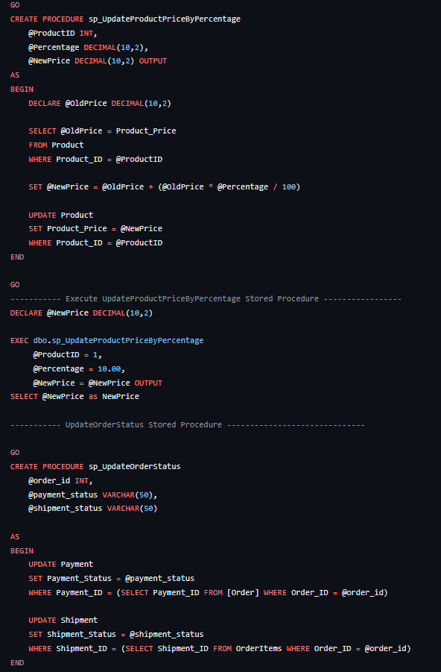

STORED PROCEDURES

Slide 6
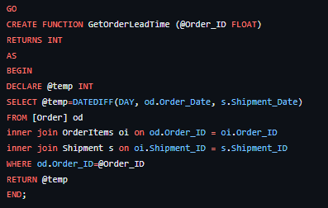
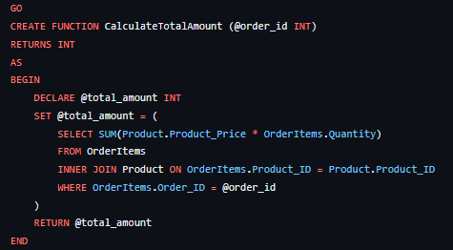
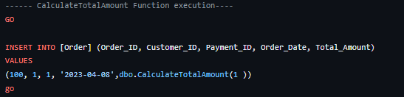
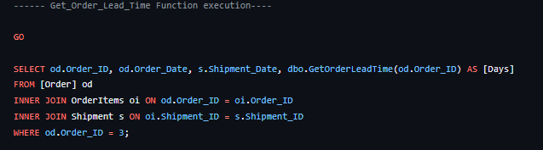
USER DEFINED FUNCTIONS

Slide 7
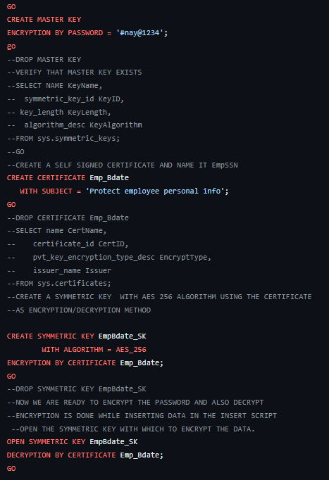
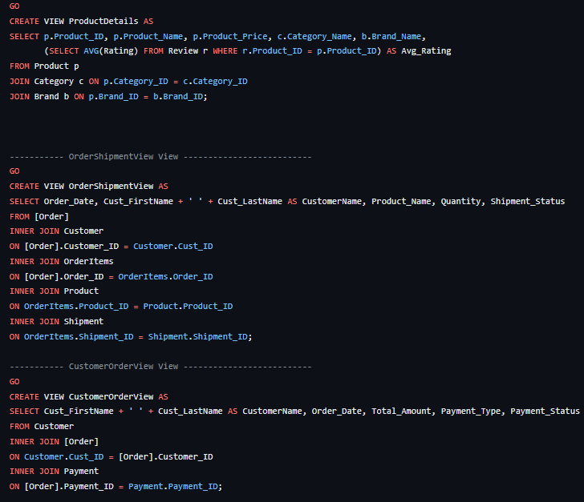
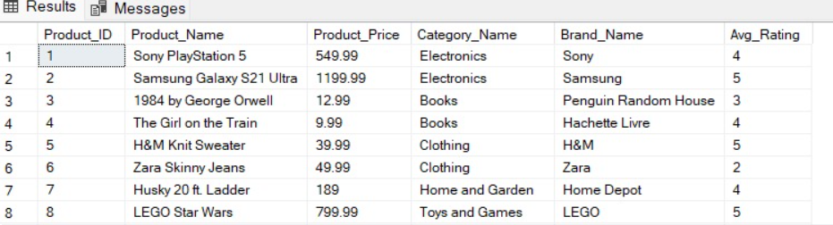
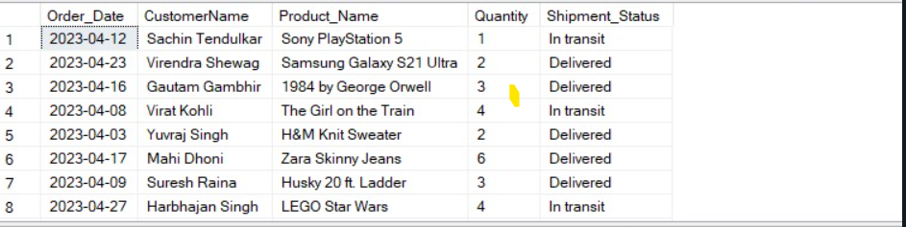
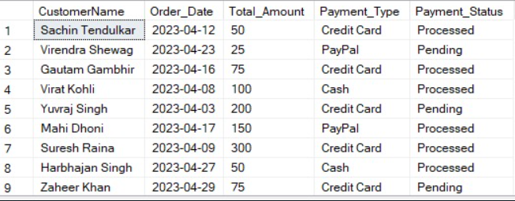
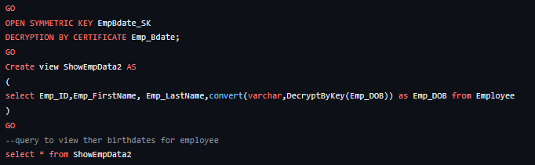
ENCRYPTION, DECRYPTION & VIEWS
Sample Views output

Slide 8
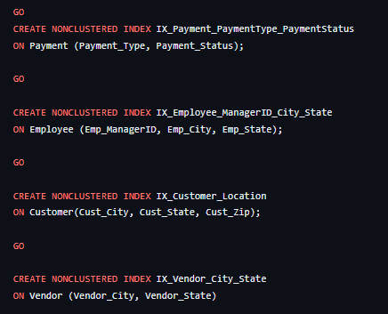
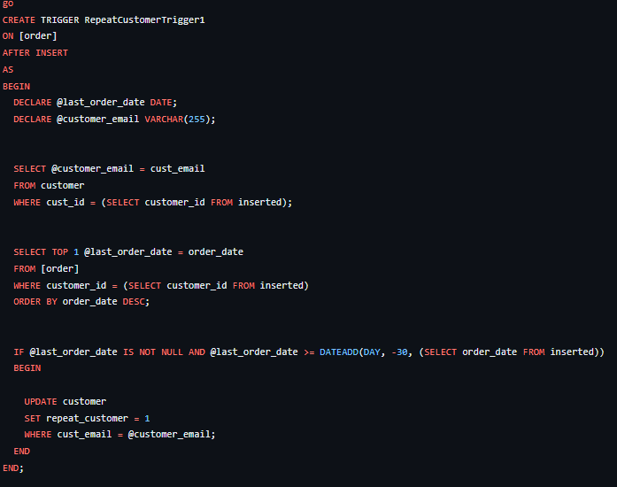
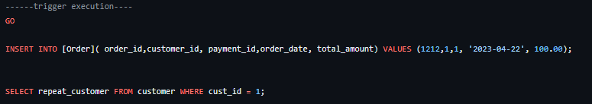
NON-CLUSTERED INDEXES & TRIGGERS

Slide 9
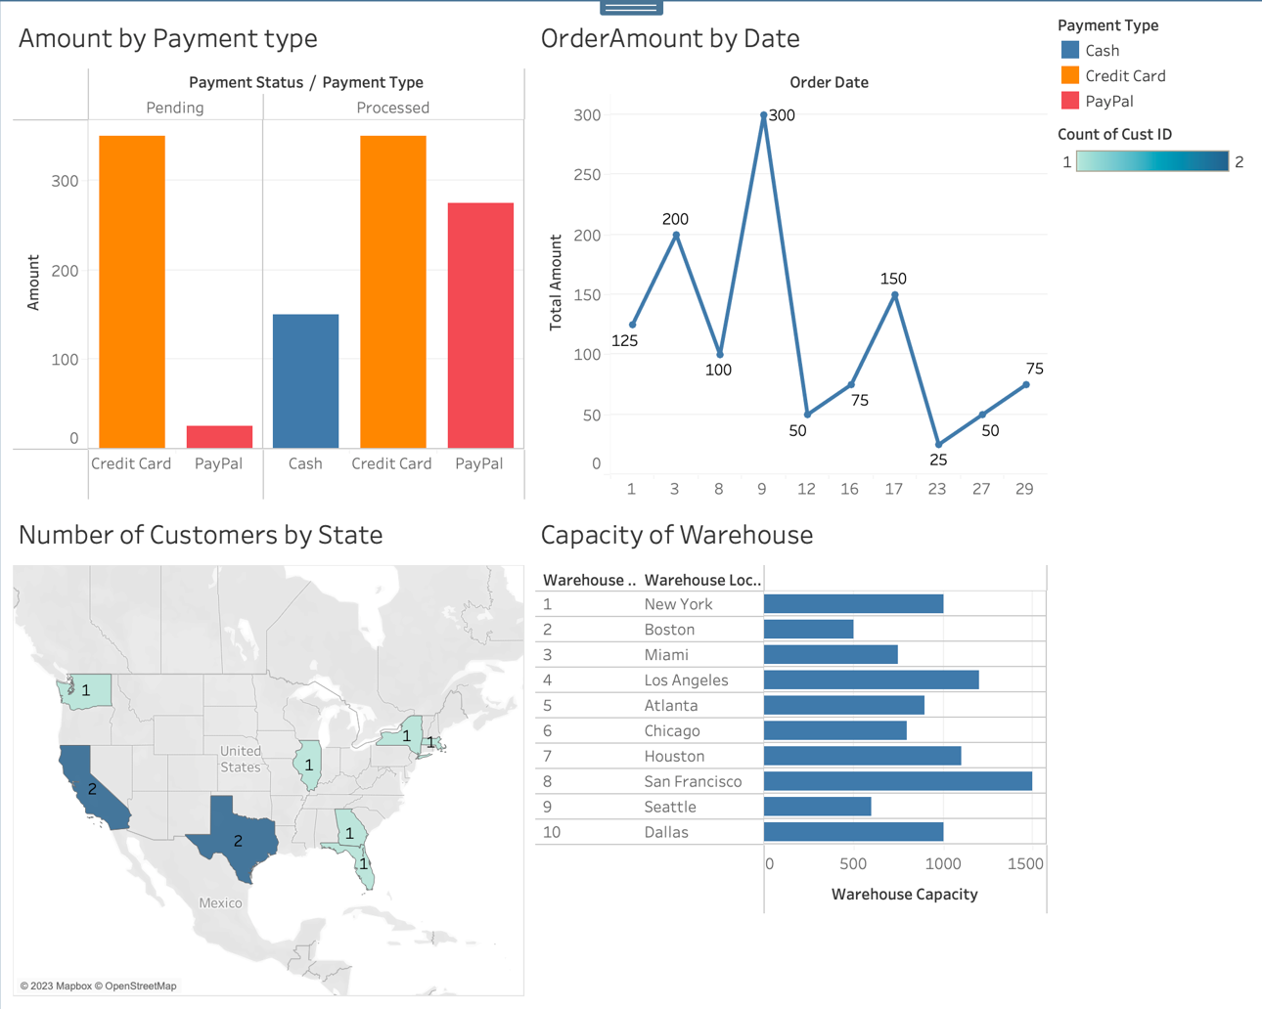
TABLEAU DASHBOARD

Slide 10
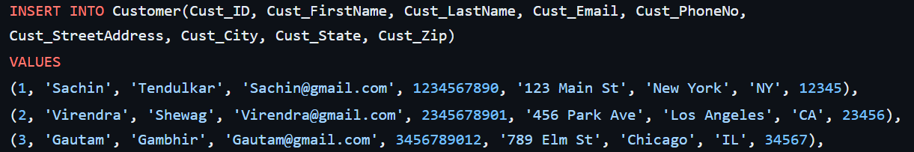
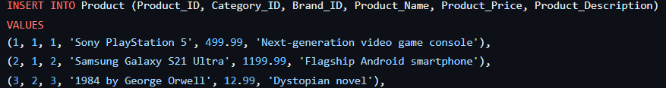
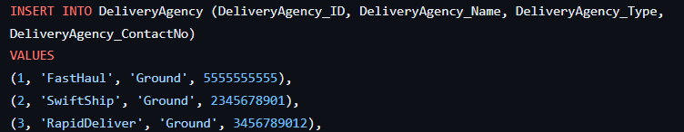
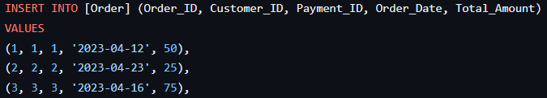
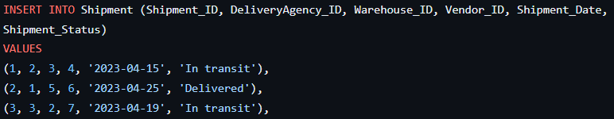
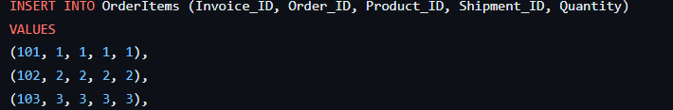

SAMPLE DATA INSERTION

